Slide 1
Introduction to Make
Prof. Darrell Long
CSE 13S

Slide 2
What’s the make program?
A utility on most Unix systems that automatically builds executable programs and libraries from source code.
Has several derivatives, one of which is GNU Make (gmake), the standard Make implementation on Linux/OSX (also on the UCSC Unix Timeshare and Ubuntu).
cmake, a cross-platform build-system generator, is a program that produces a Makefile for Unix systems.
Has a variety of command line flags/options to select from.
Requires a Makefile.

Slide 3
What’s a Makefile?
Plaintext file that contains instructions for the make.
Has a syntax like any programming language
You can think of it as a script
Typically resides in the same directory as source code and is named “Makefile”.
Composed of rules.
”A makefile is just a directed acyclic graph” – Darrell Long, 2018

Slide 4
What’s a rule?
Associated with/composed of the following:
A target
A set of dependencies
A set of commands
General structure of a rule:
target ... : dependencies ...
<TAB> command
<TAB> ...
<TAB> ...

Slide 5
What’s a target?
Basically the name of a rule.
Users specify which target to make by running “make <target_name>”.
Ex: $ make all builds the all target.
Usually the name of the file that is generated by executing the rule’s commands but can also be a name of an action to perform (a phony target).
If a target isn’t specified on the command line, make defaults to making the first rule:
Users can designate a default make target using
.DEFAULT_GOAL := <target_name>.
.DEFAULT_GOAL is an example of a special built-in target name

Slide 6
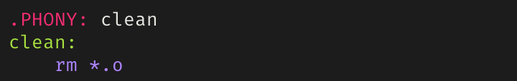
What’s a phony target?
A target that, when its rule is executed, doesn’t produce a file with the same name.
Important since it prevents make from erroneously checking for files since real and phony targets are now differentiated.
A phony target is marked as phony by simply having “.PHONY <target_name>” directly above itself.
.PHONY is another example of a special built-in target name
Example of a phony target:

Slide 7
Some conventional phony targets
clean:
Removes any files produced by running a make command.
Be careful to only remove executables and object files, not source code.
all:
Usually consists of a list of dependencies which includes all the rules defined in the Makefile.
Usually placed as the first rule so running “make” defaults to executing it.
debug:
Builds a debug version of the program
debug: CFLAGS += -g
debug: clean all

Slide 8
Some useful make flags/options
-C <dir_name>, --directory=<dir_name>
Changes to directory before looking/running any Makefiles.
-d
Print debug information in addition to any normal processing information.
-f <file_name>, --file=<file_name>, --makefile=<file_name>
Specifies the file to be read as the Makefile.
-I <dir_name>, --include-dir=<dir_name>
Specifies the directory to search in for Makefiles.
--warn-undefined-variables
Warns about referencing of undefined variables.

Slide 9
Variables in Makefiles
Four types of variable assignments in a Makefile
“=“ – lazy assignment
“:=“ – immediate assignment
“?=“ – conditional assignment
“+=“ – concatenation
To use the value of any variable, surround the variable in parentheses or curly brackets and prepend a dollar sign:
$(<variable_name>) or ${<variable_name>}

Slide 10
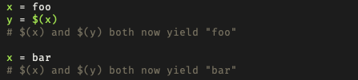
Lazy Assignment – “=“
Variables lazily assigned using the “=“ operator are called recursively-expanded variables.
Contents of the variable assignment are stored as-is, variables as variables, references as references.
make waits to expand the variable’s references until the variable is being used.
Example:

Slide 11
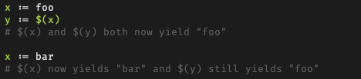
Immediate Assignment – “:=“
Variables immediately assigned with “:=“ operator are called simply-expanded variables and behave like variables in C.
Variable assignment is evaluated, and the result assigned to the variable.
If variable assignment is a variable reference, the reference is expanded before the assignment.
Example:

Slide 12
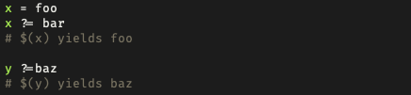
Conditional Assignment – “?=“
“?=“ behaves like “=“, except assignment occurs if and only if the variable hasn’t been assigned a value yet.
Example:

Slide 13
Concatenation – “+=“
Behaves like “=“ if the variable in question hasn’t been defined.
Essentially adds extra text to a defined variable separated by space.
Example:
x := foo
x += bar
Is equivalent to:
x := foo
x := $(x) bar
Useful for adding debug flags like “-g” to defined compiler flags.

Slide 14
What’s a dependency?
Either a target or a filename (this includes source and header files).
Ex: build: clean hello.o
The build target depends on the clean target and the hello.o file
If a rule has a dependency that has been modified or if its target doesn’t exist, make tries to fill in the dependency by executing the rule with the dependency name.
Else if the dependency hasn’t been modified or if its target already exists, make doesn’t execute the rule to make the dependency.
The above two points illustrate how make tries to be efficient; don’t make something that is already up-to-date.

Slide 15
Topological Ordering
Think of targets in a Makefile as vertices in a direct acyclic graph, and their dependency(s) representing a directed edge in said graph
A topological ordering on a Makefile ensures a linear ordering of dependencies such that for every target A that depends on some target B, B will always be compiled before A.
B
E
A
D
G
H
C
F

Slide 16
What’s a command?
An action to be executed.
Can generally use shell scripting commands (think bash commands).
A rule can have more than one command, each on its own line.
Must have a tab character in front of entire command.
clean:
<TAB> rm –f *.o hello

Slide 17
Commands, Compilers, and Compiler Flags
Variables are used to factor makefiles to make them easier to maintain.
Some conventional Makefile variables used for compiling C programs:
CC – the C compiler to use (typically gcc or cc or clang).
CFLAGS – a list of compiler flags (each flag is prefixed with a hyphen “-”).
Some good flags to use when compiling C programs:
Wall, Wextra, Wpedantic, Werror, g.
OBJ – a list of object files to build and link.
SRC – a list of source files (.c files).

Slide 18
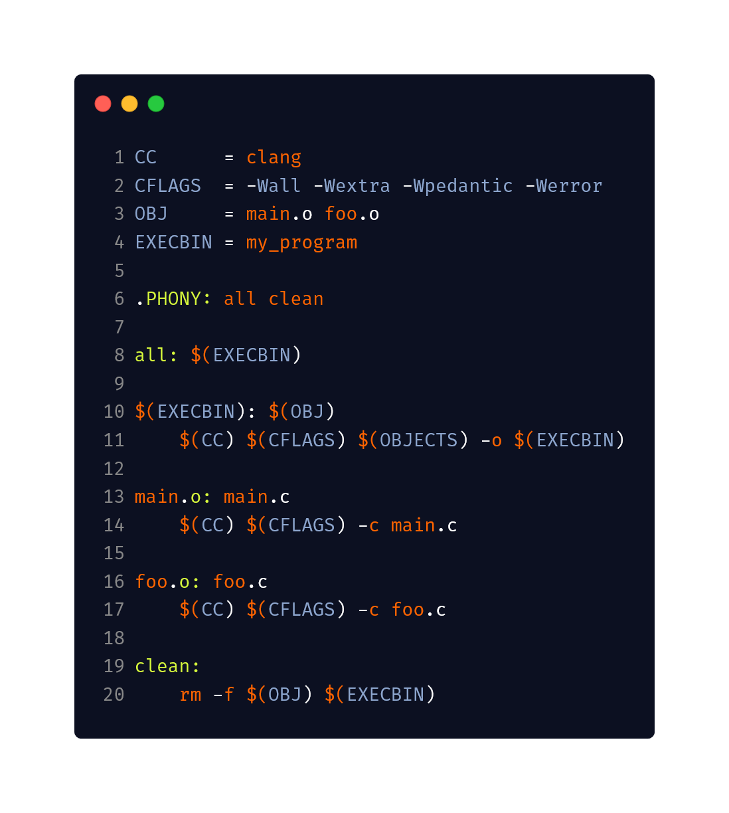
What we can do so far!
But can we make this better?

Slide 19
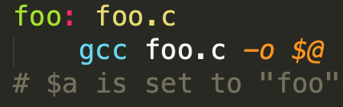
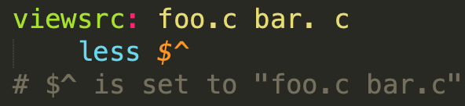
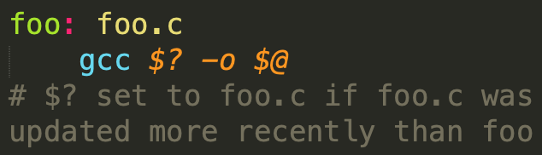
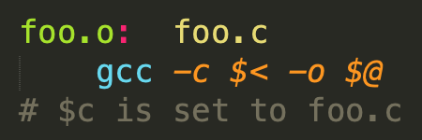
Automatic Variables
Make automatically defines some special variables within the context of an individual rule.
Some useful automatic variables:
”$@”: the name of the target.
“$^”: list of all dependencies for target.
“$?”: list of dependencies more recent than the target.
“$<“: the name of the first dependency.

Slide 20
The shell function
Communicates with the world outside of make.
Performs command expansion– takes a shell command and evaluates to the output of the command.
Newlines in command output are converted to spaces.
A useful example of the shell function:
The above example can also be done using the wildcard function.

Slide 21
The wildcard function
Can be used in rules as the “*” operator, where it is expanded by the shell.
A rule using a phony target to delete object files using wildcard:
If used for a variable assignment, wildcard expansion doesn’t occur using “*” unless the wildcard function is explicitly specified.
An example to get source files using wildcard:

Slide 22
The patsubst function
Is formatted as $(patsubst pattern, replacement, text).
Finds whitespace-separated words in <text> that match <pattern> and replaces them with <replacement>.
An example of using patsubst to get a list of object files:
Note that the above example uses the pattern match placeholder operator “%” instead of the wildcard operator “*”.
This wildcard matches any number of any characters within a word.

Slide 23
“*” vs “%”
Difference is that “*” performs expansion and “%” serves as a pattern match placeholder.
Consider the previous example where object filenames are generated by source filenames:
$(wildcard *.c) performs wildcard expansion to get all the source files.
%.c makes % match all text leading up to “.c”.
“.c” is then replaced by “.o” in all instances of a match from %.c.
The previous example can also be written as:
OBJ = $(SRC:%.c=%.o):
This effectively replaces “.c” with “.o”, which is more intuitive, but patsubst is good to know.

Slide 24
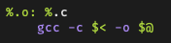
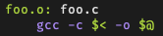
Pattern matching
Utilizes the pattern match placeholder ”%”.
Example:
When “make foo.o” is typed, this rule pattern matches to:
Note that automatic variables are needed to designate the first dependency and target names.

Slide 25
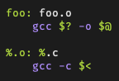
Pattern Matching (cont’d)
Great for scalability (easier to apply one rule for many many files).
Doesn’t match every filename.
Only executes if there’s a dependency that needs to be created which matches the rule.
Example:
Running $ make foo looks for “foo.o”, so the rule becomes foo.o: foo.c.
Even if there are other C files in the directory, the pattern matching isn’t executed.

Slide 26
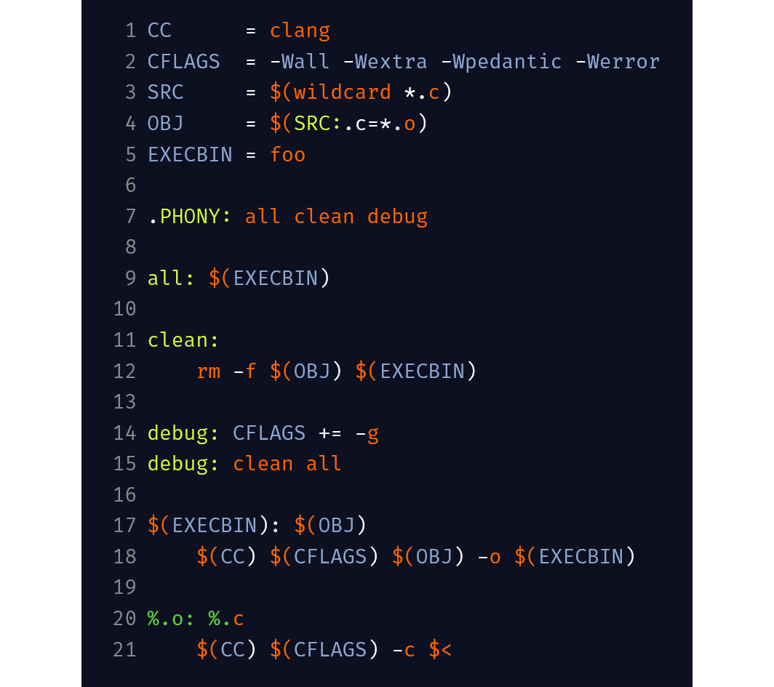
Putting it all together
Example of a generic Makefile that works for many simple programs:

Slide 27
Recursive use of make
Using make as a command in a Makefile.
Useful for when you want separate Makefiles for various subsystems that are part of a larger system.
For example:
The subsystem target recursively calls make and uses the Makefile in the subsystem directory.
You can specify options to a sub-make for flexibility when building subsystems.
subsystem:
$(MAKE) –C subsystem
subsystem-debug:
$(MAKE) –C subsystem DEBUG=y

Slide 28
Including Makefiles
A Makefile can include other Makefiles.
Useful for when various programs need to use a common set of variable definitions
You can think of it like including a header file and having a common set of variables and constants.
Another common use case is generating a prerequisite by including its Makefile and building it where needed.
For example, in a Makefile you can have the following:
It is convention for secondary Makefiles that themselves do not build the module to have a .mk extension.
However, including a Makefile overrides variables and targets with the same name. Hence, it is usually better to use a recursive approach.
include common.mk

